Slide 1
Social Media and the Church
Jeff Eckman – Senior Pastor Floyd Church of God

Slide 2
Help Me, Help You!
Name
Where are you from (City and Congregation)
Role in the church
What are you hoping to learn today?

Slide 3
What is Social Media?
An Opportunity to Connect with others, Using Technology.
Mostly… the Internet
Thanks to Smart Phones and Tablets, everyone is jumping on board.
What types of Social Media do you use?
Who do you connect with the most?

Slide 4
Should Churches Use Social Media?
What do you Think?
Here’s what I Think! (How I became a believer:)
Web Presence
Facebook got things rolling
http://www.facebook.com/profile.php?id=1337663928
Twitterpated
http://www.twitter.com/pjthedad
Blogging by a dummy
Http://www.pjtheblog.com
Don’t be a Buzz Kill

Slide 5
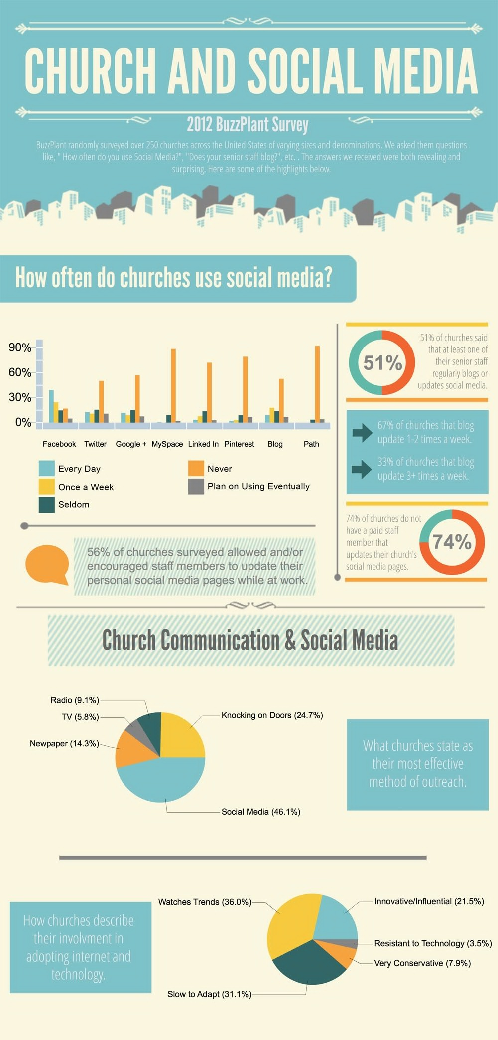
Churches ARE using Social Media

Slide 7
Are Churches Using it Effectively!
Key Elements of Social Media
relational and personal, not anonymous and generalized
dialogue and discussion, not proclamation and preaching
widespread use of the visual – photos and videos
frequently accessed 24/7 on mobile phones, not computers
Since biblical evangelism is usually relational and discussion-based, social media are an ideal match.
Don’t try to use social media as a ‘pulpit for preaching’, or as a one-way publicity tool. The foundational key is to perceive it as a ‘cafe for conversation’.
Read more: http://www.InternetEvangelismDay.com/church-social-media.php#ixzz2QGeLC0aG at Internet Evangelism Day Under Creative Commons License: Attribution

Slide 9
Suggestions for Success
Use Good Judgment about what to post…Use Better Judgment about what NOT to post!
Never Post anything that you do not want Everyone to see.
Never post info about vacations or people being away.
Never post info about others unless you have their permission.
Post more about what you are FOR, than what you are against!

Slide 10
Suggestions for Success
Understand the difference between a “Personal” Account and an “Organizational” Account
With a personal account you can freely express your thoughts (as long as you can live with the fallout:-)
With an organizational account you are representing to whole Org. BE CAREFUL!

Slide 11
Suggestions for Success
Be social…comment on, and share others posts as well as posting your own.
Participate in others conversations…don’t just demand that everyone comment on yours
Share information about community events and happenings, not just what is happening in the church.
Give kudos publicly to anyone in the community who is doing good!

Slide 12
Suggestions for Success
Update…Update…Update….
If its old or outdated information…get it off your site. www.nachog.org
If your website has unfinished pages…Hide them
If your site changes on a regular basis, People will come back.
The Word Press Advantage.

Slide 13
Suggestions for Success
Screen content, and contacts carefully.
An inappropriate relationship doesn’t have to be “in person”.
Flag inappropriate content and if it doesn’t disappear…walk away!

Slide 14
Building a Website in Five Easy Steps
www.hostmonster.com
Choose your Domain Name
Install Word Press
Start Publishing
Experiment and Try

Slide 15
www.Iknowthisguydesign.com
pj@iknowthisguydesign.com
pjthedad@gmail.com

